Slide 1
Data Structure and Algorithm
Course Code: CS-201
Topic: Sorting Techniques
Instructor: habiba arshad

Slide 2
Today’s Goal
Heap Sort
Quick Sort

Slide 3
Heap Sort
Heap sort processes the elements by creating the min-heap or max-heap using the elements of the given array. Min-heap or max-heap represents the ordering of array in which the root element represents the minimum or maximum element of the array.
Heap sort basically recursively performs two main operations -
Build a heap H, using the elements of array.
Repeatedly delete the root element of the heap formed in 1st phase.

Slide 4
Heap Sort
A heap is a complete binary tree, and the binary tree is a tree in which the node can have the utmost two children. A complete binary tree is a binary tree in which all the levels except the last level, i.e., leaf node, should be completely filled, and all the nodes should be left-justified.
The concept of heap sort is to eliminate the elements one by one from the heap part of the list, and then insert them into the sorted part of the list.
Heapsort is the in-place sorting algorithm.

Slide 5
Working of Heap Sort
In heap sort, basically, there are two phases involved in the sorting of elements. By using the heap sort algorithm, they are as follows -
The first step includes the creation of a heap by adjusting the elements of the array.
After the creation of heap, now remove the root element of the heap repeatedly by shifting it to the end of the array, and then store the heap structure with the remaining elements.

Slide 6
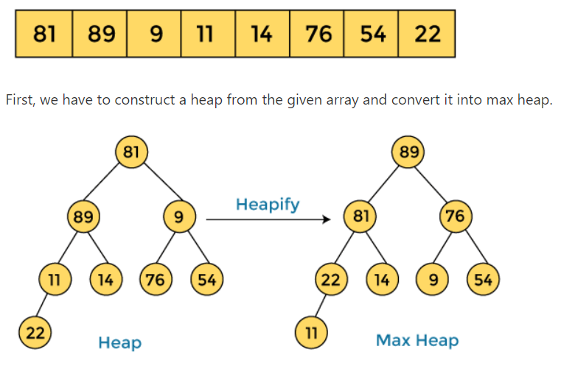
Working of Heap Sort

Slide 7
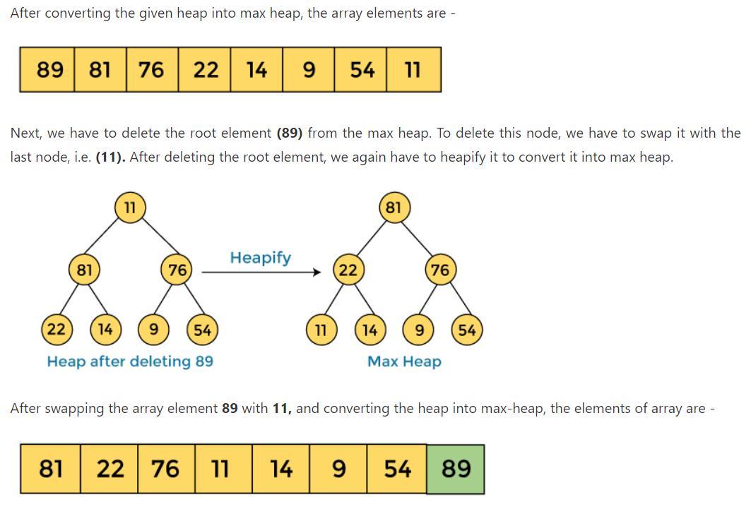
Working of Heap Sort

Slide 8
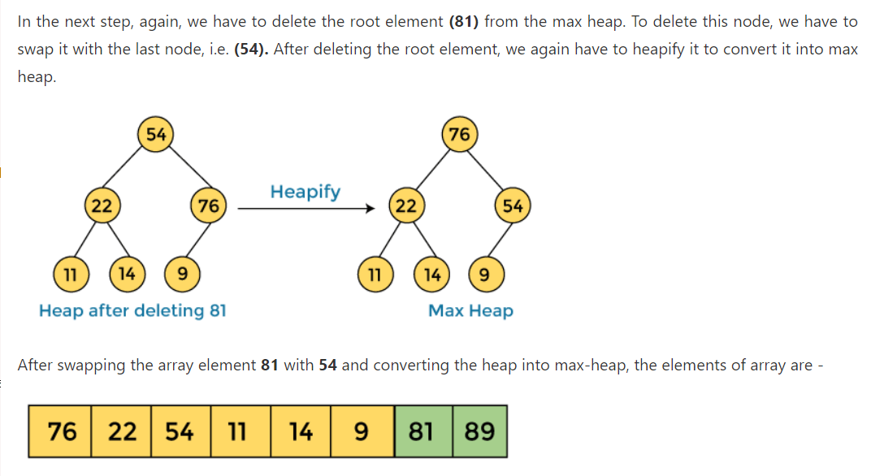
Working of Heap Sort

Slide 9
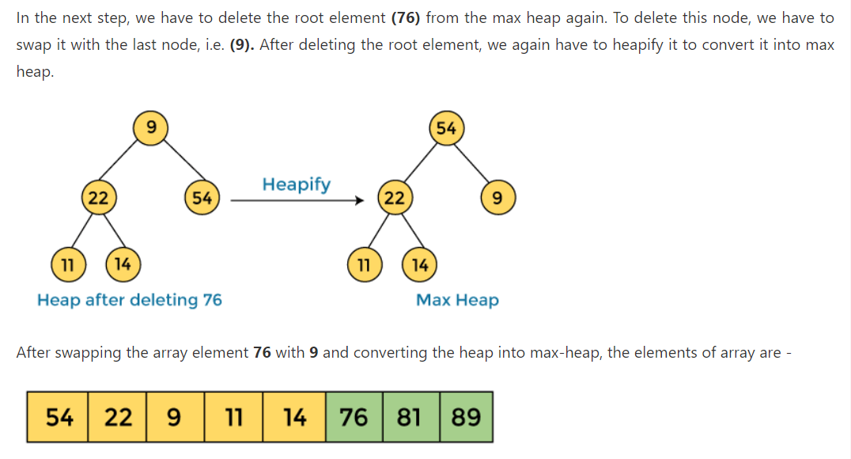
Working of Heap Sort

Slide 10
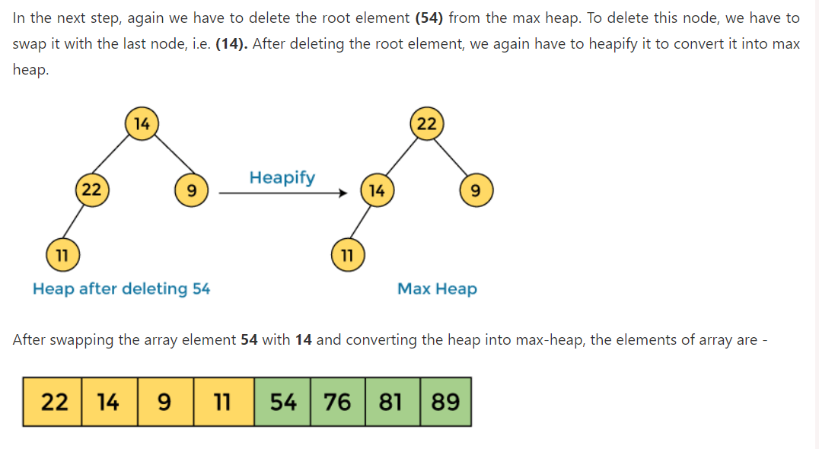
Working of Heap Sort

Slide 11
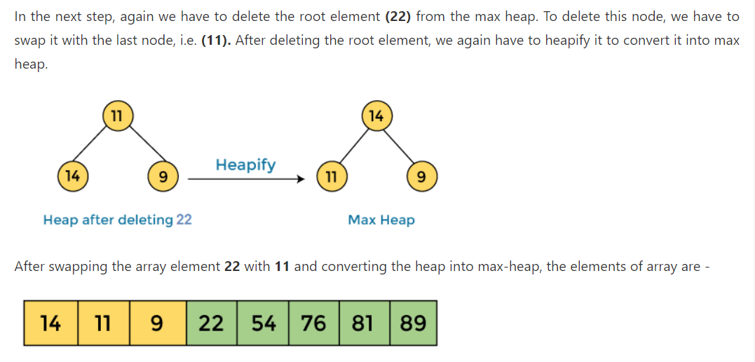
Working of Heap Sort

Slide 12
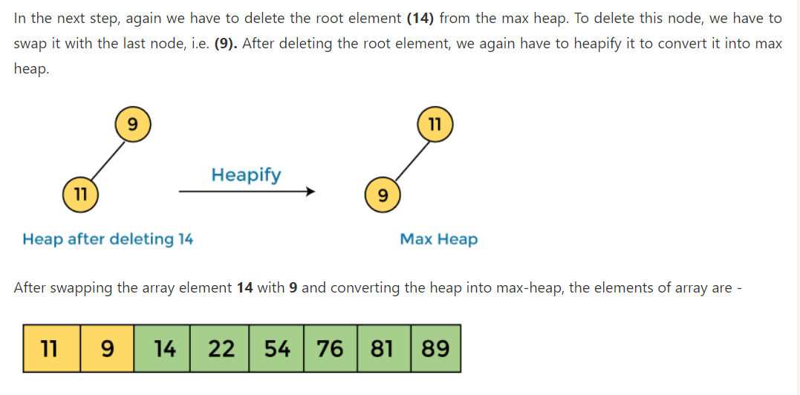
Working of Heap Sort

Slide 13
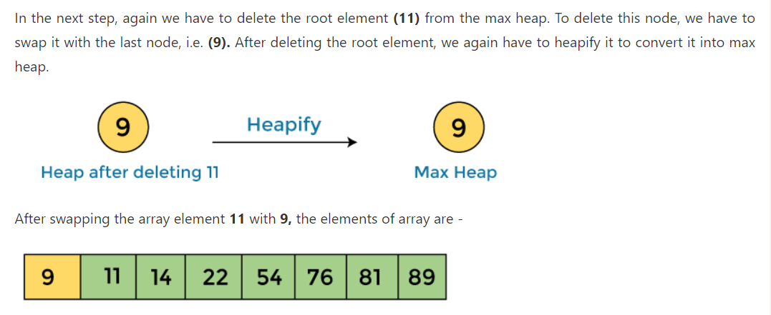
Working of Heap Sort

Slide 14
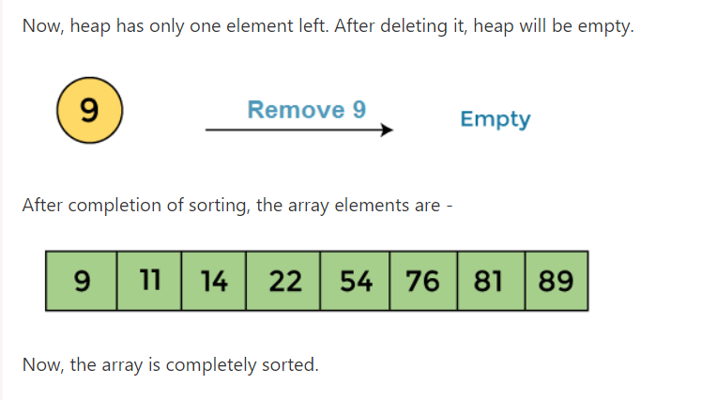
Working of Heap Sort

Slide 15
Time Complexity
Best Case: The best-case time complexity for heap sort remains O(n log n), as regardless of the input arrangement, the process involves building a heap and performing subsequent removals which each take logarithmic time.
Worst Case: The worst-case time complexity also clocks in at O(n log n). This happens due to maintaining the heap during element extraction, which involves index adjustments at each level of the heap structure.
In both scenarios, the consistent time complexity signifies its efficiency across diverse data layouts.

Slide 16
Space Complexity
A key feature of heap sort in comparison to other sorting methods is its efficient use of memory: The space complexity for heap sort is O(1), which means it sorts the list in place. This stands in contrast to methods such as Merge Sort, which require additional storage space proportional to the size of the dataset. The in-place sorting mechanism of heap sort not only enhances performance for larger data sets but also streamlines operation within constrained memory contexts.

Slide 17
Quick Sort Algorithm
Quick sort is a highly efficient sorting algorithm and is based on partitioning of array of data into smaller arrays.
A large array is partitioned into two arrays one of which holds values smaller than the specified value, say pivot, based on which the partition is made and another array holds values greater than the pivot value.
Quicksort partitions an array and then calls itself recursively twice to sort the two resulting subarrays.
This algorithm is quite efficient for large-sized data sets as its average and worst-case complexity are O(n2), respectively.
Notes:
http://www.openbookproject.net/books/pythonds/SortSearch/TheQuickSort.html

Slide 19
Quick Sort Basics
Quick sort uses divide and conquer to gain the same advantages as the merge sort.
The list is logically divided in half.
Pivot value
A quick sort first selects any value from array , which is called the pivot value.

Slide 20

Step: 01 Pivot Value
What is the pivot value in above array:
First item of array
Last item of array
Select Pivot Randomly
The pivot value is used to split the list.

Slide 21

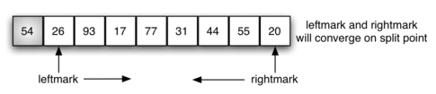
Step 2: Left Mark and Right Mark

Slide 22
Step 3: Rule for Pivot value
Left: The array element on the leftmark must be greater than the pivot value.
Right: The array element on the right mark must be less than the pivot value.

Slide 23

Step 4: Rule for Pivot value
Left: The array element on the leftmark must be greater than the pivot value.
Right: The array element on the right mark must be less than the pivot value.

Slide 24
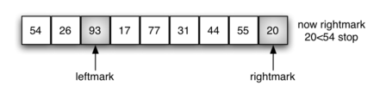
Step 5: Rule for Pivot value
Left: The array element on the leftmark must be greater than the pivot value.
Right: The array element on the right mark must be less than the pivot value.

Slide 25

Step 6: Exchange
Left: The array element on the leftmark must be greater than the pivot value.
Right: The array element on the right mark must be less than the pivot value.

Slide 26
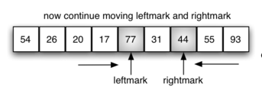
Step 7: Continue according to rules
Left: The array element on the leftmark must be greater than the pivot value.
Right: The array element on the right mark must be less than the pivot value.

Slide 27

Step 8: Exchange
Left: The array element on the leftmark must be greater than the pivot value.
Right: The array element on the right mark must be less than the pivot value.

Slide 28
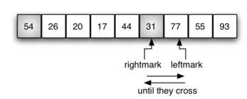
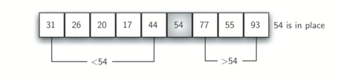
Step 9: Continue as per rules
Left: The array element on the leftmark must be greater than the pivot value.
Right: The array element on the right mark must be less than the pivot value.
In case, when left mark and right mark cross each other than exchange the pivot with the right mark

Slide 29
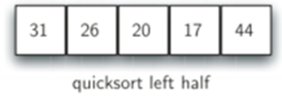
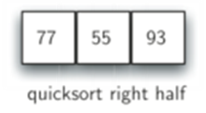

Slide 30
54
31 | 26 | 20 | 17 | 44
77 | 55 | 93
Left Mark
Right Mark
Left Mark
Right Mark
54
31 | 26 | 20 | 17 | 44
77 | 55 | 93
Right Mark
Left Mark
Right Mark
Left Mark
Crossed exchange right mark with pivot
Crossed exchange right mark with pivot

Slide 31
54
17 | 26 | 20 | 31 | 44
55 | 77 | 93
Left Mark
Right Mark
54
17 | 26 | 20 | 31 | 44
55 | 77 | 93
Right Mark
Left Mark
Crossed exchange right mark with pivot

Slide 32
Sorted Array
17 | 20 | 26 | 31 | 44 | 54
55 | 77 | 93

Slide 33
Exercise
10 | 80 | 30 | 90 | 40 | 50 | 70

Slide 34
Quick Sort analysis
To analyze the quickSort function, note that for a list of length n, if the partition always occurs in the middle of the list, there will again be log n divisions.
In order to find the split point, each of the n items needs to be checked against the pivot value. The result is nlogn.
In addition, there is no need for additional memory as in the merge sort process.
Unfortunately, in the worst case, the split points may not be in the middle and can be very skewed to the left or the right, leaving a very uneven division.
In this case, sorting a list of n items divides into sorting a list of 0 items and a list of n−1 items.
Then sorting a list of n−1 divides into a list of size 0 and a list of size n−2, and so on. The result is an O(n2) sort with all of the overhead that recursion requires.

